Slide 1
College website
Linux squad

Slide 2
AGENDA
Introduction
Primary goals
Users
What we learned
Summary

Slide 3
INTRODUCTION
We are trying to build the college website as a major project .the goal is to learn to the website building using the latest technologies available

Slide 4
PRIMARY GOALS
Help students
Learn website technologies
Collaborative workflow
Leadership and team management

Slide 5
To create the awareness
Students now a days has a lot of choices available but they are not aware of the those choices this website will help about creating awareness about the courses and the employment opportunities available

Slide 6
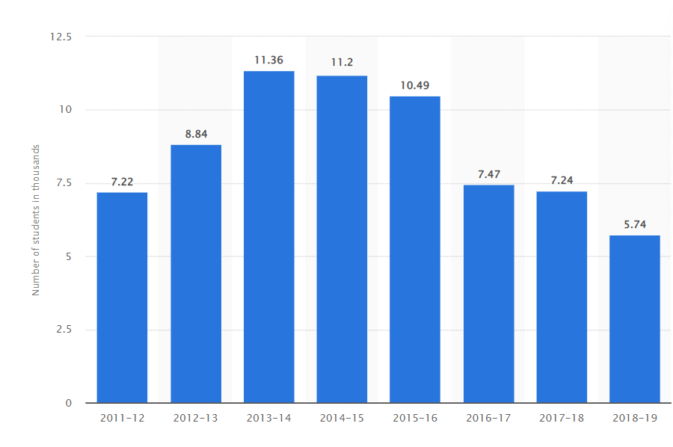
Studetns enrolled in diploma

Slide 7
Who will be our users
Students currently studying the college
Students who want to get admission
Parents who want to know about campus
Students willing to contact

Slide 8
Technologies used
HTML
CSS
JS
GIT & Github

Slide 9
What we learned​
As you know learning is important so here is the thing we learned from this project
How to build basic and beautiful website using Html and ....CSS
How to use the JS for simple animation and bringing ….responsiveness to the website
How to use version control system like Git
Howe to use code hosting platform like Github

Slide 10
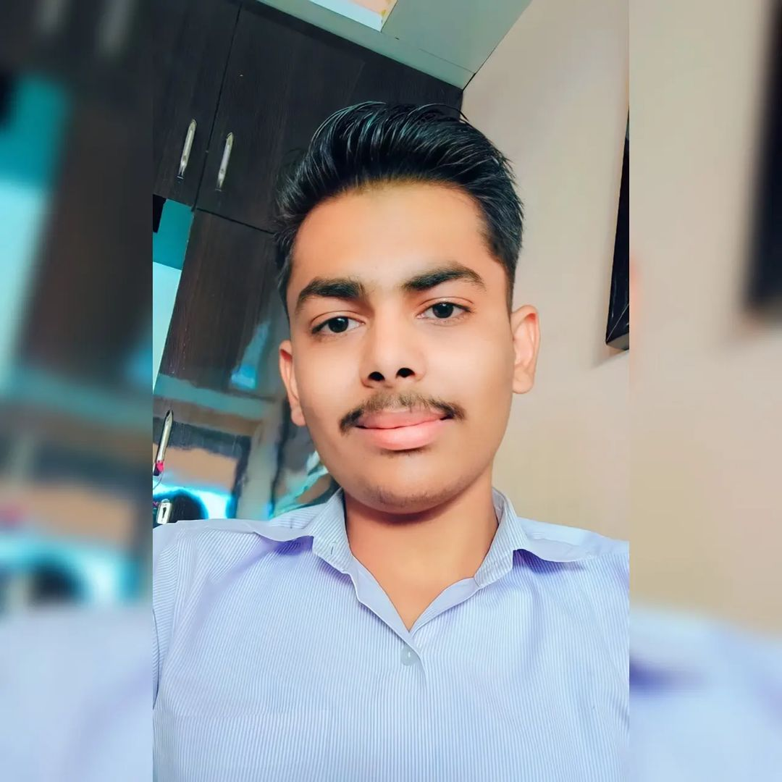
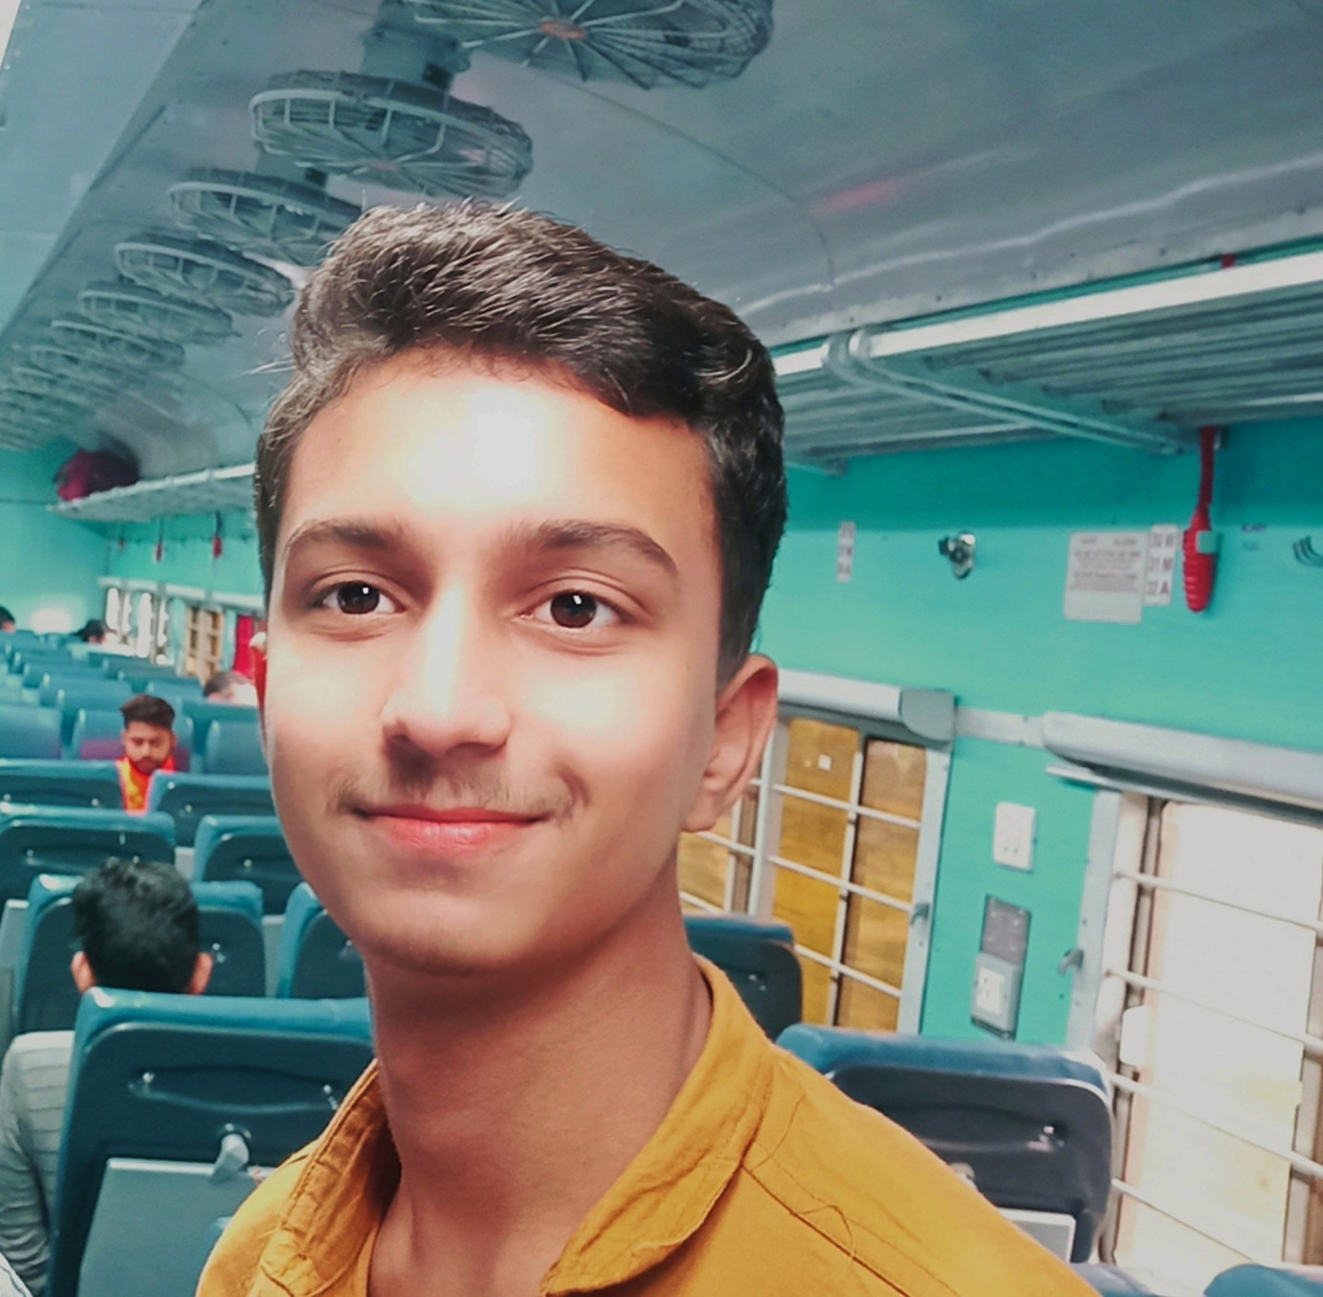
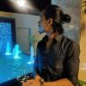

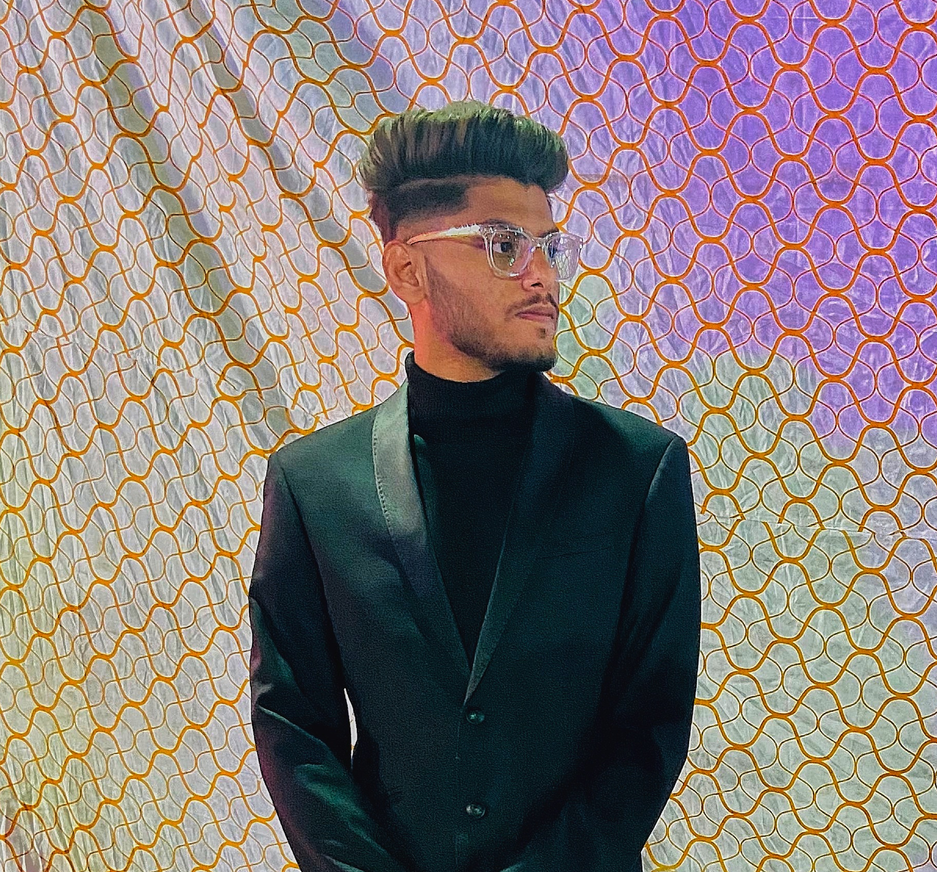
MEET OUR TEAM
Aayush Malviya
Anuj Malviya
Sourabh Sarathe
Rohit Pachlaniya
Syed Zaid Ali

Slide 11
Facalities
Description about college
Image gallery
Syllabus
Contacts
About teachers
Description about the courses

Slide 12
YOUR QUESTIONS
Q1
Q2
Q3
Q4

Slide 13
THANK YOU
- Linux squad

